Slide 1
7. Ensemble Learning (II)
IT 348/448

Slide 2
Topics
Ensemble Learning
Bagging
Boosting
Random Forest

Slide 3
Goal of Supervised Learning?
Minimize the probability of model prediction errors on future data
Two Competing Methodologies
Build one really good model
Traditional approach
Build many models and average the results
Ensemble learning

Slide 4
Ensemble Philosophy
Build many models and combine them
Only through averaging (or voting) do we get at the truth!
It’s too hard (impossible?) to build a single model that works

Slide 5
Ensembles’ advantage
Ensembles are more effective
when the individual models in ensembles are uncorrelated

Slide 6
Bagging’s disadvantage
Unfortunately, bagging decision trees often ends up giving highly correlated K trees
An attribute with a very high information gain is likely to be the root of most of decision trees

Slide 7
Random Forest

Slide 8
Random Forest
Random forest is identified as a collection of decision trees.
Each tree estimates a classification, and this is called a “vote.”
we say the tree "votes" for that class
Ideally, we consider each vote from every tree and choose the most voted classification (Majority-voting).

Slide 9
Random Forest
Introduce two sources of randomness: “Bagging” and “Random input vectors”
Bagging method: each tree is grown using a bootstrap sample of training data
Random vector method: At each node, best split is chosen from a random sample of p attributes instead of all attributes

Slide 10
How to grow each tree
Construct an ensemble of decision trees by manipulating training set as well as features
Use bootstrap sample to train every decision tree (similar to Bagging)
Use the following tree induction algorithm:
At every internal node of decision tree, randomly sample p attributes for selecting split criterion
Repeat this procedure until all leaves are pure (unpruned tree)

Slide 11
Similarity and difference between Random Forest and Bagging
Random Forest follows the same bagging process as the decision trees
The difference
Each time a split is to be performed
the search for the split variable is limited to a random subset of p attributes from the M attributes (i.e., variables or features), where M is the number of attributes in the original training dataset
Split-Attribute Randomization
Note that if p = M, then this is bagging.

Slide 12
Bias and Variance
In general,
Bias is contributed to by the training error; a complex model has low bias.
Variance is caused by future error; a complex model has high variance.

Slide 13
RF Characteristics (1)
Base classifiers are unpruned trees and hence are unstable classifiers.
Base classifiers are decorrelated
Due to randomization in the training set as well as features
By restricting each split-test to a small, random sample of features, we can decrease the correlation between trees in the ensemble.
RF reduces the variance of unstable classifiers without negatively impacting the bias

Slide 14
RF Characteristics (2)
Random forests tend to have excellent performance.
Because the trees are less correlated.
Increasing the number of individual randomized models in an ensemble
will never increase the generalization error.
Therefore, less overfitting exists in RF

Slide 15
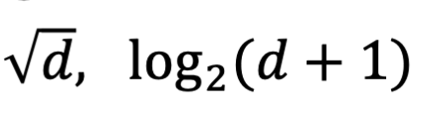
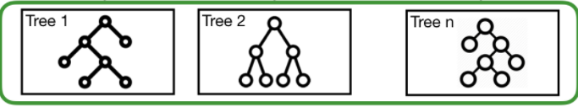
RF Characteristics (3)
Selection of hyper-parameter p
Small value ensures lack of correlation
High value promotes strong base classifiers
Common default choices:
Random Forests produce many unique trees.

Slide 16
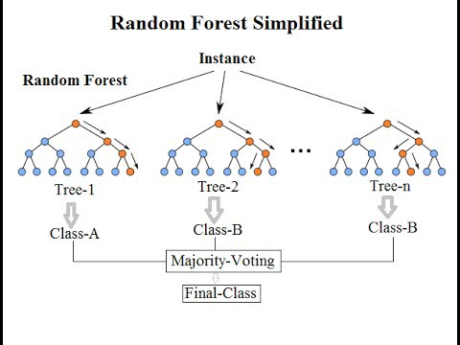
How to use the learned model (i.e., the Random Forest Classifier)

Slide 17
Random Forest – strengths & weaknesses
Strengths
More robust to errors and outliers
Insensitive to the number of attributes selected for consideration at each split
Faster than bagging or boosting
Typically, overfitting is unlikely
Competitive performance
Provide automatic feature selection
Weaknesses
Can become slow on large datasets
Less interpretable (or explainable)
XAI (Explainable AI)

Slide 18
Readings
Geron, Chapter 5
Muller & Guido, Section 2.3.6 (p.84)
See the reference in /Readings/ in Canvas
Section 8.6 in Classification_Basic.pdf

